Slide 1

Logic Design
Computer Organization

Slide 2


1. Intro
Lesson 4 Review
Logic Equations
Laws of Boolean Algebra
De Morgan’s Theorem
Simplifying Boolean Expressions
Practice

Slide 3
Logic Gates
Notes:
A logic gate is an idealized model of computation or physical electronic device implementing a Boolean function, a logical operation performed on one or more binary inputs that produces a single binary output.
Logic gates are primarily implemented using diodes or transistors acting as electronic switches, but can also be constructed using vacuum tubes, electromagnetic relays (relay logic), fluidic logic, pneumatic logic, optics, molecules, or even mechanical elements. With amplification, logic gates can be cascaded in the same way that Boolean functions can be composed, allowing the construction of a physical model of all of Boolean logic, and therefore, all of the algorithms and mathematics that can be described with Boolean logic.

Slide 4
Digital Design Basics
Two voltage levels – high and low (1 and 0, true and false)
Hence, the use of binary arithmetic/logic in all computers
A transistor is a 3-terminal device that acts as a switch
V
V
0
V
V
Conducting
0
Non-conducting
0
0
Notes:
Since AND is commutative and associative, an AND gate can have multiple inputs, with the output equal to the AND of all the inputs.
The same is true of OR.

Slide 5
Logic Block
A logic block has a number of binary inputs and produces
a number of binary outputs – the simplest logic block is
composed of a few transistors
A logic block is termed combinational if the output is only
a function of the inputs
A logic block is termed sequential if the block has some
internal memory (state) that also influences the output
A basic logic block is termed a gate (AND, OR, NOT, etc.)
Notes:
Since AND is commutative and associative, an AND gate can have multiple inputs, with the output equal to the AND of all the inputs.
The same is true of OR.

Slide 6
Truth Table
A table of all possible inputs and the associated outputs for a particular circuit
All combinational logic can be completely described using a truth table
Non-zero output truth tables only list the inputs that result in non-zero outputs
Text example: for all values of A, B, and C, let D be true if at least one input is true, let E be true if exactly two inputs are true, and let F be true only if all three inputs are true.
Notes:
Since AND is commutative and associative, an AND gate can have multiple inputs, with the output equal to the AND of all the inputs.
The same is true of OR.

Slide 7
Boolean Algebra
binary OR is written +
logical sum
result is 1 if at least one variable is 1
binary AND is written *
logical product
result is 1 only if both variables are 1
unary NOT is written `A
Notes:
Boolean algebra is the category of algebra in which the variable’s values are the truth values, true and false, ordinarily denoted 1 and 0 respectively. It is used to analyze and simplify digital circuits or digital gates.

Slide 8
Gate
A gate is a device that implements basic logic functions, such as AND or OR.
Logic blocks are built from gates that implement basic logic functions.
The logical function NOT is implemented with an inverter that always has a single input.
Notes:
Since AND is commutative and associative, an AND gate can have multiple inputs, with the output equal to the AND of all the inputs.
The same is true of OR.

Slide 9
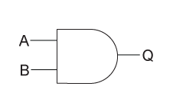
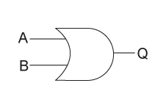
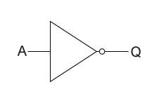
Gate
AND
OR
NOT (inverter)
Notes:
Tour Logisim functionality
Wired each gate (AND, OR, NOT)
Test result
Build Truth Table

Slide 10
Laws of Boolean Algebra

Slide 11
Terminologies
A boolean variable represents logical values such as 0 or 1
A boolean function is a function whose arguments and result assume values such as 0 or 1. For example f(a, b, c)
A complement is the inverse of a boolean variable
A boolean expressions are the logical statements that use logical operators such as AND, OR, and NOT

Slide 12
Rules
A variable can have only two values binary 1 for HIGH or binary 0 for LOW
The complement of a variable can be represented by an overbar ( ̅a ), an apostrophe ( ‘a ), a backtick ( `a ), an exclamation point ( !a ). We’ll ONLY use backtick. Therefore, the complement of B is equal to `B
For example,
If B = 0 then `B = 1
If B = 1 then `B = 0

Slide 13
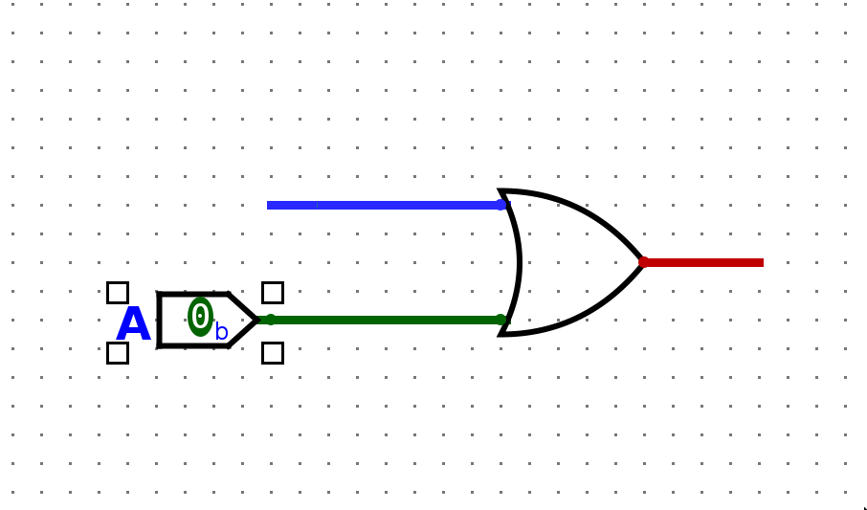
Logical OR
The four possible logical OR operations:
A + 0 = A
A + 1 = 1
A + A = A
A + `A = 1

Slide 14
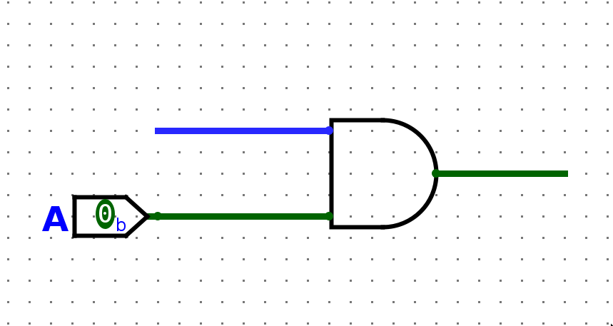
Logical AND
The four possible logical AND operations:
A * 0 = 0
A * 1 = A
A * A = A
A * `A = 0

Slide 15
Basic Laws
Commutative law is when the order in which the variables are ordered makes no difference.
A + B = B + A
A * B = B * A
Associative law is when the result is the same regardless of the grouping of the variables.
(A + B) + C = A + (B + C)
(A * B) * C = A * (B * C)
Distributive law is when multiplication (AND) is distributed over addition (OR)
A + (B * C) = (A + B) * (A + C)
(A * B) + (A * C) = A * (B + C)

Slide 16
DeMorgan’s Theorem

Slide 17
DeMorgan’s Theorem
De Morgan’s theorem states that complementing the result of OR’ing variables together is equivalent to AND’ing the complements of the individual.
It is used to prove that a NAND gate is equal to an OR gate with inverted inputs.
`(A * B) = `A + `B
`(A + B) = `A * `B
Useful for finding the complement of Boolean functions.

Slide 18
Logic Equations

Slide 19
Simplifying Boolean Expressions

Slide 20
2. End
HOMEWORK ***
Collaborate on Slack
Laws of Boolean Algebra, Boolean Expressions, Truth Table
Complete practice problems
Download Logisim-evolution
Test that you are able to run on your computer.

